Slide 1




WITTY
PROJECT
Breaking The Third World Fence

Slide 2

ExecutiveSummary
OUR VISION
The Witty ecosystem consists of custom made products and services ranging from; Automated Crypto Trading System (Spot and Leverage Trading) Decentralized Peer to Peer Exchange, Crypto Lending Platform, Crypto Staking Platform, Crypto Payment Gateway, Cart & Affiliate System, Witty Fund. Africa needs Blockchain more than Blockchain needs Africa, therefore the Witty project seeks to remain a frontliner in driving Africa’s goal towards the much-needed financial inclusion that has marred economic growth in Africa for many decades.
Witty [WTY] is the native token that powers the entire Witty Ecosystem. It's a low-cap supplied DeFi/Governance token built on Binance Smart Chain, and its main purpose is to be used as a payment method for accessing all products and services in our ecosystem.
Playing the Major Role in Breaking the Third World Fence by Leveraging Permissionless and Trustless Technologies."
OUR CREED
"Nigeria is our Springboard, Africa is our Platform, the World is our Stage."
OUR TAGLINE
"Business Beyond Borders. “

Slide 3

DAN EWAH
Dan Ewah (fondly called Dannish by his buddies) is a Blockchain Angel Investor, Digital Marketing Consultant/Growth Hacker, and Founder of WITTY CLUB.
Dan is a three-time company Co-Founder. He has a Finance background having worked with United Bank for Africa, he’s been active in the Digital Marketing space since 2002 and the Cryptocurrency space since 2016.
Dan has 13+ years of professional working experience but has had side gigs as a wanna-be entrepreneur since 2002 during his University days. He’s passionate about creating awareness for Financial Education, Digital Marketing, Network Marketing, and how to leverage the Cryptocurrency space to achieve Financial Freedom.
In the last 26 months, he has spoken to a collective audience of over 52,000 people; he mentors a dedicated group of people in a Business Growth Club. Dan is a natural leader, with an ability to mobilize people towards a cause he believes in, he’s very resilient never taking a No for an answer. Here are some of his core skills and competencies;
Forward Thinking
Calculated Risk-Taking
Strategist Constructively Tough Minded
Pragmatically Inclusive
Measured Emotion
Team Builder
Willingness to Trust
He loves Reading, Public Speaking, and Travelling. He trained as an Economist at Ebonyi State University in Nigeria; he’s currently an Executive MBA student in the prestigious Lagos Business School. His driving principle is one of the quotes by the legendary Zig Ziglar which says “You can have everything in life that you desire If only you can help enough other people get what they desire.
CO-FOUNDER / CEO / CMO
http://www.linkedin.com/in/danewah/

Slide 4

ARINZE JOHN OKAFOR
Arinze is a Certified Blockchain and Network Security Expert with over 10 years’ industry Experience.
He is the Convener of CyberChain, [ Nigeria's most engaging and peoplefocused Cybersecurity and Blockchain Conference]. He is a founding member of the Nigeria Blockchain Association [ SIBAN ]. And he is also the current Vice-President, Policy and Regulation of the Association [ Stakeholders in Blockchain Technology Association of Nigeria -SIBAN].
Arinze has served in advisory roles to several Blockchain and Cryptocurrency projects in the last 3 years.
His Competencies cut across;
ICT/Digital Solutions
Project Management
Blockchain Technology
FinTech
E-commerce
Cybersecurity
Arinze is an optimist, and a strong advocate of Integrity as a Culture in Business. Over the past 4 years, Arinze has championed the drive for mass adoption of emerging technologies of the 4th Industrial Revolution, especially Blockchain Technology and Cybersecurity. He’s currently running an M.Sc program in Blockchain and Digital Currency in the University of Nicosia, Cyprus [ UNIC ].
CO-FOUNDER / COO
https://www.linkedin.com/in/arinze-john/

Slide 5
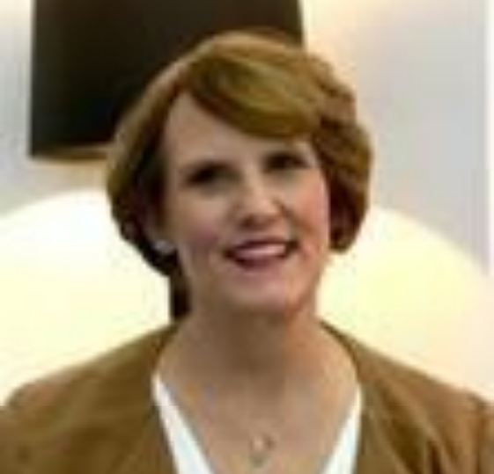
LINDA LESSLE
Linda is a Certified Finance Analyst from the United Kingdom; she has 36 years of working experience cutting across Finance and IT. She’s had experiences working with companies like Barclays Bank, Medical Aid Fund, Lexicon Business Systems, ITWEB, TNA Media, LLaLe Capital,
Quantity Surveyor, and Project Management Services, and Intersys IT Limited. Linda has a set of core competencies and hard skill, they include but not limited to;
Risk Assessment/Management
Compliance
Audit
Treasury Management
Financial Forecasting
Management of Information Systems
Corporate Governance
She has excellent interpersonal and communication skills, a balanced personality, high working capacity, strong service attitude and she’s a commercial visionary who is able to sell company core values and interest to the stakeholders – Customers, Auditors, Consultants, Advisors, Regulatory Bodies, Liquidity Providers, and Employees.
CHIEF FINANCIAL OFFICER - CFO

Slide 6
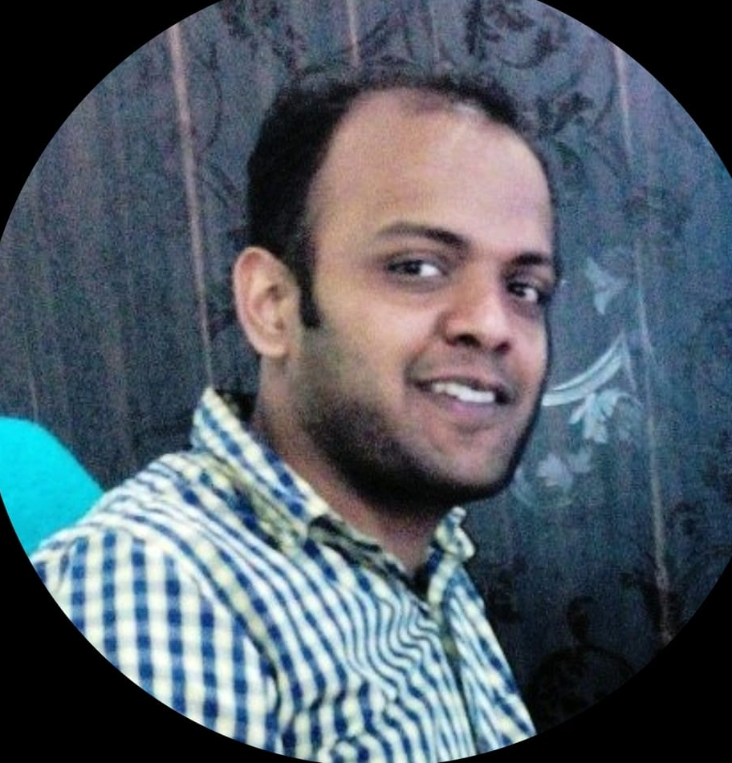
JATIN GOYAL
Jatin Goyal is the Founder of Vincit Software and Consulting Private Limited; He’s an experienced full-stack Engineer who is proficient in end to-end Blockchain Development with 9+ years of active experience. Jatin is a solutions-oriented IT-Software/Blockchain Developer and Programmer highly regarded for more than 9 years of progressive experience in developing, implementing, and supporting complex infrastructures and technical solutions for the Blockchain and Technology industry.
Here are some of his core skills and competencies;
Experienced in working with open-source projects and community activities.
Strong knowledge of common algorithms and data structures.
Strong knowledge of bitcoin-like and Ethereum-like blockchain, Tendermint, EVM.
Advanced knowledge of cryptography (symmetric/asymmetric, hash, signatures).
Experienced with popular consensus mechanism (POW, POS, POA, etc) & P2P network.
Proficient in Linux OS and Linux commands.
Proficient in Cloud Computing (AWS, Google Cloud, Azure, AliCloud).
Proficient in Docker Container Technologies, Kubernetes.
Proficient in the following Object Oriented languages: TypeScript/JavaScript, C++, Go-Lang, Java,
Rust
Proficient in NodeJS, NPM, GIT repositories, open-source tools & technologies.
Proficient in Key Value Databases (Redis, LevelDB, etc).
Experienced in project management.
Familiar with Front-end development (Angular, React, Vue js, etc).
Strong knowledge of Databases (MySQL, PostgreSQL, MongoDB, etc).
He has a Bachelor of Technology degree (BTech) from Maharshi Dayanand University Rohtak.
CHIEF TECHNOLOGY OFFICER [CTO]

Slide 7
Token Structure
The Witty project will issue and launch a 20 Million Maximum/Total Supply [WTY] token and List on a public Exchange concurrently. WTY token is built on the hybrid Binance Smart Chain and it will leverage the fast and scalable features of the BSC interoperability.
Witty token [WTY] will utilize a unique consensus algorithm [Proof-of-Concept] to implement governance in our entire ecosystem. POC rewards users who conduct further research on the Witty ecosystem and develop a proven feasible concept that could
contribute to the further advancement of the entire Witty project. Such a concept/idea will go through a voting process by the community, after which final judgment will be passed and the concept will be adopted for further development and implementation.
Witty token [WTY] is capped at a maximum supply of 20,000,000 [ Twenty Million] token forever, with a circulating supply of 1,000,000 [ One Million] token only for the First two [2] years after which it will commence 5% emission annually [after the first 2 years,only 5% of the remaining total supply will be emitted annually].

Slide 8
TOKEN DISTRIBUTION
REVENUE DISTRIBUTION
TOTAL TOKEN SUPPLY: 20,000,000
CIRCULATING SUPPLY: 1,000,000
WTY for first 2 YEARS [Till 2023]
Company Reserves
in Digital Assets
A
10%
20,000,000
Total Token Supply
1,000,000
Circulating Supply
C
WTY
Symbol
Witty
Token Name
Core Team Reward
40%
Commissions
15%
E
REVENUE ALLOCATION
REVENUE ALLOCATION
40% - Commissions
20% - Development of UseCases & Maintenance of Ecosystem
15% - Marketing
15% - Core Team Reward
10% - Company Reserve in Digital Assets.
C
15%
Marketing
D
20%
Development of Use Cases & Maintenance of Ecosystem

Slide 9
Our Use Cases
Witty Fund
Lending Platform
Crypto Remittance Platform
Crypto payment gateway system
Crypto Staking Platform
Decentralized Peer to Peer crypto exchange platform
Automated Crypto Trading System

Slide 10
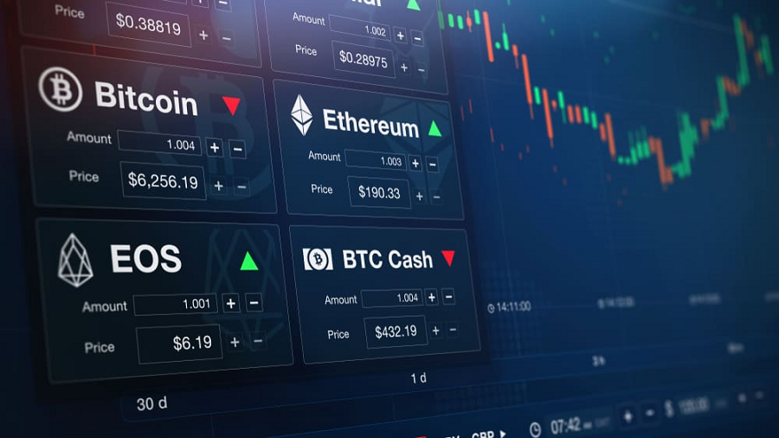
WITTY
AUTOMATED
CRYPTO
TRADING SYSTEM
ENGLISH
PRESENTATION
Page 10

Slide 11

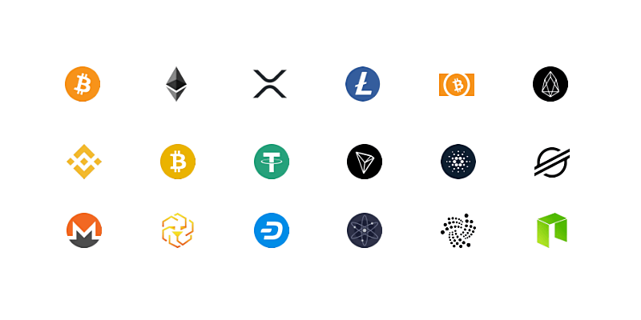
Two Undisputable Facts About Cryptocurrency
Cryptocurrency is the most profitable asset class in the world
Cryptocurrency is a good hedge against Inflation
JOIN NOW
Page 11

Slide 12


One Way To Make Money From Cryptocurrency Is Through Trading
But there is a PROBLEM though! It requires steep learning curve. You can loose all your money if you are not coefficients at Trading
Page 12

Slide 13
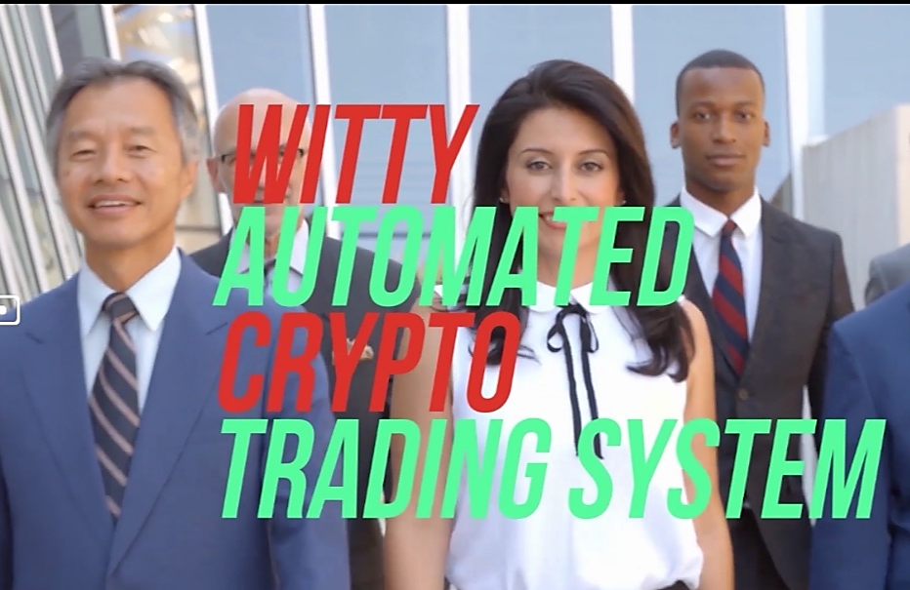
But We’ve Got A Solution
Beginner Friendly
Profit-Conscious
Hands- Free Way
Page 13

Slide 14

Why Choose Witty Automated Trading System
No Need to Know How To Trade
You Don’t Need To Give Anybody Your Money
Your Trading Capital Never Stops Working For You
Nobody Is Sharing Profits With You
There’s Absolutely No Contract
It’s Impossible To Get Scammed
It’s A Permissionless & Trustless System
Page 14

Slide 15
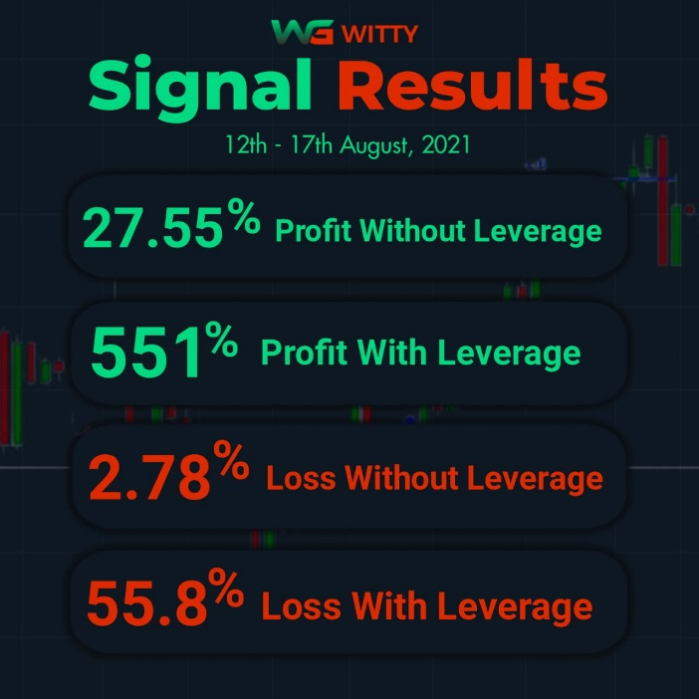
Four Steps To Get Started
Fund Your Binance Account With Your Trading Capital
Setup Your Simple Configuration
Subscribe To The Automated Trading System
Smart Pack - $100 (BNB)
Premium Pack - $200 (WTY)
Link Your API From Binance To Our System
12th – 17th AUG 2021
Enjoy A Monthly Win Rate Of 85%
85%
74%
Page 15

Slide 16
Witty Compensation Plan
Level
Compensation
Commission
Qualification
01
20%
02
3%
A user must personally refer 3 people to start earning from L2
03
3%
A user must personally refer 6 people to start earning from L3
04
3%
A user must personally refer 9 people to start earning from L4
05
5%
A user must personally refer 12 people to start earning from L5
06
6%
A user must personally refer 20 people to start earning from L6
07
7%
A user must personally refer 25 people to start earning from L7
08
10%
A user must personally refer 30 people to start earning from L8
09
10%
A user must personally refer 40 people to start earning from L9
10
30%
A user must personally refer 50 people to start earning from L10
JOIN NOW
Page 16

Slide 17




Decentralized P2P Exchange
It's a platform where you can exchange Cryptocurrencies to fiat or fiat to crypto.
We support these crypto currencies
BTC
BNB
ETH
USDT
WTY
Bitcoin
Binance Coin.
Ethereum
Tether
Witty Token.

Slide 18
You are earning from unlimited people up to 3 generations
LEVELS | COMMISSION %
Level 1 | 40%
Level 2 | 15%
Level 3 | 5%
Passive Income
This has the capacity to settle anybody who takes it serious The following is the Unique Selling Point of our P2P
One
It's non-custodial- it's very safe, not even me or the Government of any nation can freeze or get a hold on your money
Five
The Remittance feature of our P2P is an added advantage.
Four
Our Global referral link is an added advantage as our users will make money across multiple use cases.
The Global referral link also ensures that all users remain active as you need to be active to keep earning, this strategy guarantees that you keep making money as your downlines want to remain active to earn from their own downlines too
Two
It's Global - it supports the most popular languages. There are 5 most popular languages, we support all 5 of them
Three
We currently have the most generous compensation plan of all exchanges

Slide 19
Staking Platform
It's a platform that allows people stake or deposit their witty token for rewards.
It also has a possibility of increasing the price of the witty token after the staking period.
DIAMOND
SILVER
GOLD
PLATINUM
$500
Daily 0.015%
$2,000
Daily 0.07%
$5,000
Daily 0.2%
$10,000
Daily 0.45%
Monthly = 6%
Yearly = 72%
Monthly reward withdrawable but capital locked for 1 year
Monthly = 0.45%
Yearly = 5.4%
Monthly reward withdrawable but capital locked for 1 year
Monthly = 2..1%
Yearly = 25.2%
Monthly reward withdrawable but capital locked for 1 year
Monthly = 13.5%
Yearly = 162%
Monthly reward withdrawable but capital locked for 1 year
By SOBTONE
Page 19

Slide 20
5%
Referral Commission
1st Level
3%
IF YOU TERMINATE
IF YOU TERMINATE
2nd Level
1
BEFORE 3 MONTH
We’ll charge you 50% Of The WITTY
2%
3rd Level
2
BEFORE 4-8 MONTHS
We’ll charge you 30% Of The WITTY
3
BETWEEN 9-11 MONTHS
We’ll charge you 20% of The WITTY
Page 20

Slide 21
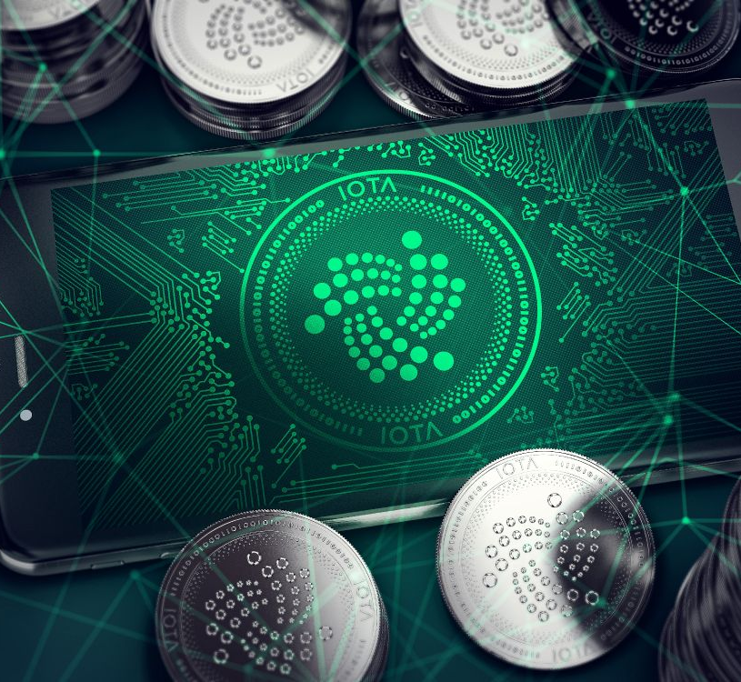
Our Other Use Cases
Crypto Remittance Platform
Crypto Lending Platform
Crypto Payment Gateway System
WITTY Fund

Slide 22
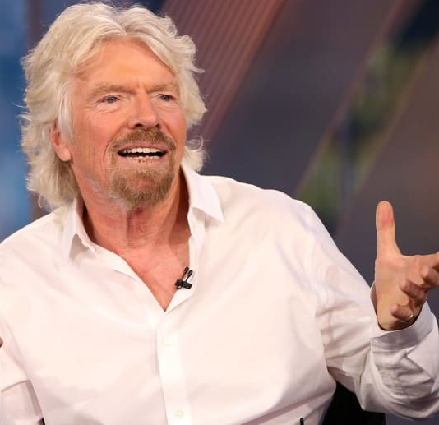
If somebody offers you an amazing opportunity but you are not sure you can do it, say yes – then learn how to do it later!
By: Richard Branson

Slide 23
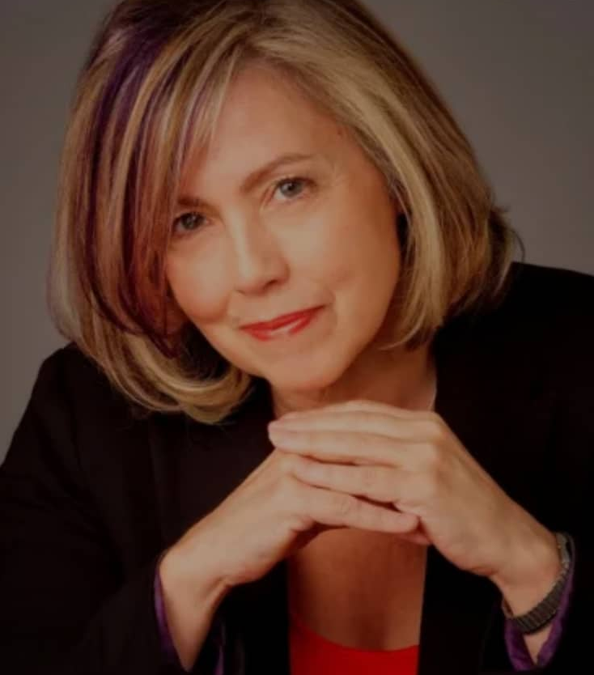
A year from now, you will wish you had started today
By: Karen Lamb

Slide 24
THANK YOU
CONTACT THE PERSON WHO INVITED YOU FOR THIS PRESENTATION AND JOIN THE WITTY CLUB TODAY

